Slide 1
Discussion & Lecture Session Sound & Recording Check
Remote participants:
Log into Join.me
Announce yourself and provide your name on the phone and/or in the chat session
For Screen Sharing utilize your computer
For conference call audio utilize your computer speakers and microphone OR dial into the session with your mobile phone
Onsite participants:
Sit in a good spot near the “speaker phone” if possible
Optionally sign into Join.me… but make sure that your microphone and speakers are muted/off
Test recording by starting recording and then stop recording after a few seconds
Check recording sound when video is released by Join.me

Slide 2

Software Engineering Discussion, Lecture, & Lab Eric Pogue
Agenda for Wednesday, January 29th
Friendly Conversation Topic
Announcements & Prework
Sprint 2 Retrospective
The Righteous Triangle
Sprint 3 Planning
Requirements
Assignment
Lab
Discussion & Questions welcome at any time… please be present with no phones or email during our time together

Slide 3
Teamwork and Self-Improvement

Slide 4
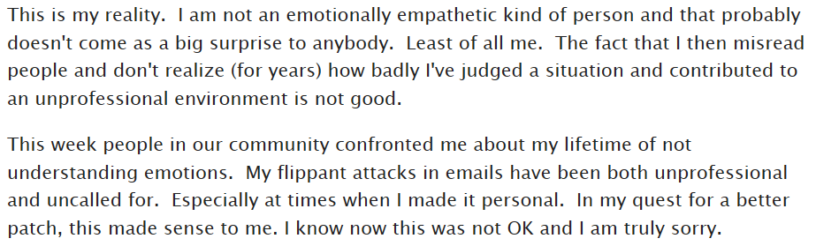
Who is the Author

Slide 5

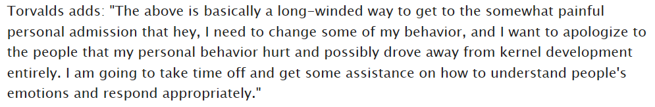
Answer

Slide 6
Suggested Reading: Dale Carnegie

Slide 7
Notes:
Optimism & Good-natured Humor

Slide 8
Announcements & Prework

Slide 10

Scrum Process – Sprint Retrospective
By Dr ian mitchell - Own work, CC BY-SA 4.0, Link
Notes:
Calendar, Activities List, and Assignments

Slide 11
Feedback?

Slide 12
Sprint 3 Planning

Slide 13
The Righteous Triangle of Software Development
People & Organizations
Technology & Tools
Process & Roles

Slide 14
Scrum Process – Sprint Planning
By Dr ian mitchell - Own work, CC BY-SA 4.0, Link

Slide 16
Requirements

Slide 17
The Righteous Triangle of Software Development
People & Organizations
Technology & Tools
Process & Roles

Slide 18
Behavior-Driven Development (Design)
In software engineering, behavior-driven development (BDD) is an Agile software development process that encourages collaboration among developers, QA and non-technical or business participants in a software project.^{[1][2][3]} It encourages teams to use conversation and concrete examples to formalize a shared understanding of how the application should behave.^{[4]} It emerged from test-driven development (TDD).^{[1][2][5][6][vague][7]} Behavior-driven development combines the general techniques and principles of TDD with ideas from domain-driven design and object-oriented analysis and design to provide software development and management teams with shared tools and a shared process to collaborate on software development.^{[2][7]}
From Wikipedia, the free encyclopedia
Notes:
What is the term that Jeremy used for doing it in the place?

Slide 19
Gemba
Genba (現場, also romanized as gemba) is a Japanese term meaning "the actual place". Japanese detectives call the crime scene genba, and Japanese TV reporters may refer to themselves as reporting from genba. In business, genba refers to the place where value is created; in manufacturing the genba is the factory floor. It can be any "site" such as a construction site, sales floor or where the service provider interacts directly with the customer.^{[1]}
In lean manufacturing, the idea of genba is that the problems are visible, and the best improvement ideas will come from going to the genba. The gemba walk, much like Management By Walking Around (MBWA), is an activity that takes management to the front lines to look for waste and opportunities to practice genba kaizen, or practical shop floor improvement.
In quality management, genba means the manufacturing floor and the idea is that if a problem occurs, the engineers must go there to understand the full impact of the problem, gathering data from all sources. Unlike focus groups and surveys, genba visits are not scripted or bound by what one wants to ask.
From Wikipedia, the free encyclopedia
Notes:
What is the term that Jeremy used for doing it in the place?

Slide 20
User Interface Design
User interface design (UI) or user interface engineering is the design of user interfaces for machines and software, such as computers, home appliances, mobile devices, and other electronic devices, with the focus on maximizing usability and the user experience. The goal of user interface design is to make the user's interaction as simple and efficient as possible, in terms of accomplishing user goals (user-centered design).
Good user interface design facilitates finishing the task at hand without drawing unnecessary attention to itself. Graphic design and typography are utilized to support its usability, influencing how the user performs certain interactions and improving the aesthetic appeal of the design; design aesthetics may enhance or detract from the ability of users to use the functions of the interface.^{[1]}
From Wikipedia, the free encyclopedia
Notes:
What is the term that Jeremy used for doing it in the place?

Slide 21
Waterfall vs Iterative vs Agile Requirements
 | Waterfall | Iterative | Agile
References | United States Department of Defense: DOD-STD-2167A (1985) | Rational Unified Process (RUP) Open Unified Process | Scrum Kanban Scaled Agile Framework (SAFe)
Priorities | Planning and predictability | Architecture, modeling, and efficiency through early detection & fixing of issues (verification) | Responsiveness to feedback, efficiency through engineering practices, early detection & fixing of issues, and validation
Principles | Execute phases sequentially: Requirements Analysis Design Coding Testing and Operations Define and commit to Scope, Cost, and Timeline “early” Implement strict Change Control | Develop and test iteratively Manage requirements Use components Model visually Verify quality Control changes | Develop, test, deploy, and release iteratively Capture lightweight near term requirements Empower teams Allow requirements to evolve but maintain fixed timelines Apply engineering practices and systems thinking (e.g. TDD) Integrate early user feedback into remaining plan Maintain a collaborative approach between all stakeholders
Notes:
The views on testing and change management have changed dramatically as organizations have moved from Waterfall to Iterative to Agile development lifecycles.
Successful Agile (and Iterative) Development REQUIRES better application design, development techniques, and testing practices.
Testing and lack of defects are not the end goal. A higher quality more usable more cost-effective product is the goal.
Requirements:
Waterfall:
Full project requirements upfront
Inconsistent industry capture techniques
Tend to be verbose requirements with formal signoff
Change requests needed
Estimation bottom up detailed estimates sometimes function points
Iterative:
Mostly upfront

Slide 22
Requirements – Waterfall
When working in a Waterfall SDLC Requirements are generally:
Captured up front (before any design or development)
Documented in a variety of formats
Verbose
Estimated in detail using bottom-up estimating techniques (sometime Function Points)
Risk Analysis & Mitigaton
Signed off on
Managed with change requests
Notes:
Grace period until Monday morning a 6am CT

Slide 23
Requirements – Iterative (RUP)
When working in an Iterative (RUP) SDLC Requirements are generally:
Captured primarily up front but updated during design
Documented in Use Cases
Moderately verbose
Estimated using Use Case points
Signed off on with an understanding that minor changes are likely
Managed with change requests
Notes:
Grace period until Monday morning a 6am CT

Slide 24
Requirements – Agile (Scrum)
When working in an Agile (Scrum) SDLC Requirements are generally:
Captured before each sprint
Documented using Stories (light weight)
In Scaled Agile Epics & Features are also used
Only detailed as needed
Estimated using Story Points (very light weight)
Immutable for current sprint
Change is encouraged for future sprints
Notes:
Final Topics:
SMART: Specific, Measurable, Achievable, Relevant, and Time-boxed
Be very careful attempting to measure productivity across teams
Story Points vs Use Case Points vs Function Points

Slide 25
Requirements
Final Thoughts:
SMART Stories: Specific, Measurable, Achievable, Relevant, and Time-boxed
Be very careful attempting to measure productivity across teams
Story Points vs Use Case Points vs Function Points
User Experience is a big deal and often overlooked
Notes:
Final Topics:

Slide 26
Assignment
ALL Assignments & Activity List Items are due this Sunday.
Prework assignments for next sprint will be communicated by Monday noon
Notes:
Grace period until Monday morning a 6am CT

Slide 27
Break & End of First Recording

Slide 28
Lab
As A Group:
Deploy Node.js to Azure

Slide 29
End of Session & Recordings

